Slide 1
Spring ORM

Slide 2
Introduction:
Spring comes with a family of data access frameworks that integrate with a variety of data access technologies. You may use direct JDBC, iBATIS, or an object relational mapping (ORM) framework like Hibernate to persist your data. Spring supports all of these persistence mechanisms.

Slide 3
Hibernate
Hibernate is an open source project whose purpose is to make it easy to integrate relational data into Java programs. This is done through the use of XML mapping files, which associate Java classes with database tables.
An enhanced, object-based SQL variant for retrieving data, known as Hibernate Query Language (HQL).
The goal of Hibernate is to allow object-oriented developers to incorporate persistence into their programs with a minimum of effort.

Slide 4
Why to Integrate Hibernate with Spring
The very first benefit is the Spring framework itself. The IoC container makes configuring data sources, transaction managers, and DAOs easy.
It manages the Hibernate SessionFactory as a singleton – a small but surprisingly annoying task that must be implemented manually when using Hibernate alone

Slide 5
Integrating Hibernate with Spring
A typical Hibernate application uses the Hibernate Libraries, configures its SessionFactory using a properties file or an XML file, use hibernate session etc. Now let’s discuss the steps we must follow while integrating Hibernate with Spring.
Step 1: Set Hibernate Libraries in classpath.
Step 2: Declare a bean in Spring Config file for Hibernate Session Factory.
Step 3: Inject session factory into Hibernate template.
Step 4: Inject hibernate template into DAO classes.
Step 5: Define the property HibernateTemplate in each DAO classes.
Step 6: Use hibernate Queries through Hibernate Template object in DAO.
Let’s discuss all these steps one by one.

Slide 6
Step 1: Set Hibernate Libraries in classpath
To integrate Hibernate with Spring, you need the hibernate libraries along with Spring.
So the first step should be downloading all the necessary library jars for Hibernate and set those jars into the project classpath just like you already have set the Spring libraries..

Slide 7
Step 2: Declare a bean in Spring Config file for Hibernate Session Factory
A typical Hibernate application uses the Hibernate Libraries, configures its SessionFactory using a properties file or an XML file, use hibernate session etc. Now let’s discuss the steps we must follow while integrating Hibernate with Spring.
A typical Hibernate application configures its SessionFactory using a properties file or an XML file.
First, we start treating that session factory as a Spring bean.
Declare it as a Spring <bean> and instantiate it using a Spring ApplicationContext.
Configure it using Spring <property>s, and this removes the need for a hibernate.cfg.xml or hibernate.properties file.
Spring dependency injection – and possibly autowiring – make short work of this sort of configuration task.
Hibernate object/relational mapping files are included as usual.

Slide 8
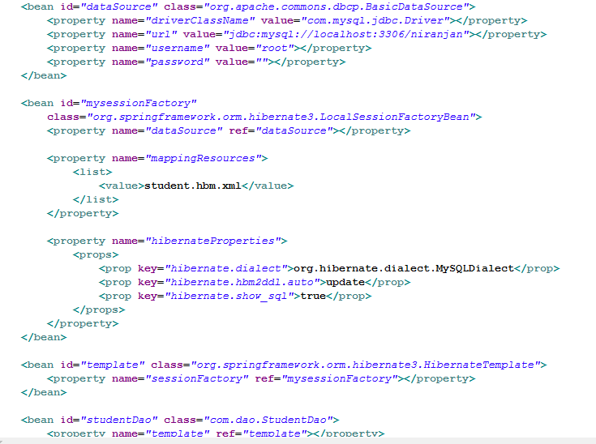

Slide 9

Step 3: Inject session factory into Hibernate template.
Step 4: Inject hibernate template into DAO classes.

Slide 10
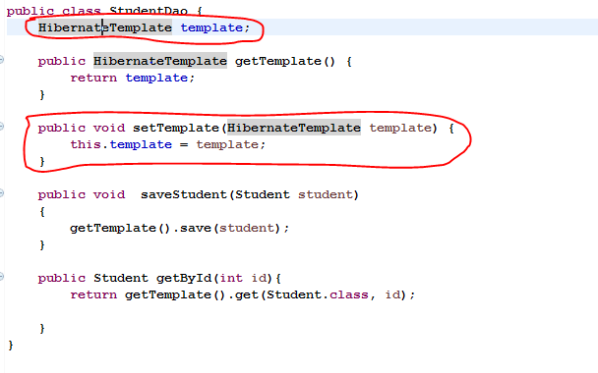
Step 5: Define the property HibernateTemplate in each DAO classes

Slide 11
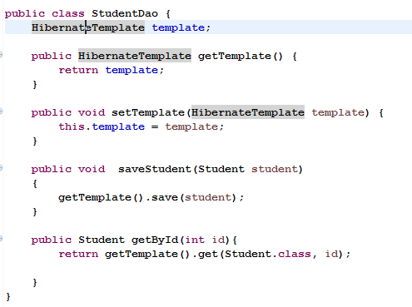
Step 6: Use hibernate Queries through Hibernate Template object in DAO.

